Slide 1
A fast algorithm for constructing trees from distance matrices
Joseph C. Culberson Piotr Rudnicki
Information Processing Letters 30 (1989) p.215–p.220
Presenter: Chung-Han Chiang
Date: Jan. 18, 2007

Slide 2
Abstract
We present an algorithm which given a tree-realizable distance matrix constructs the tree in optimal O(n²) time. For tees of bounded degree k, the algorithm runs in O(knlog_{k}n) time, and for random trees apparently runs in O(n) average time. We show the algorithm can be used to test tree-realizability of a distance matrix.

Slide 3
Introduction
We use a distance matrix to construct a weighted tree.
T = < V, E, f > be a weighted tree.
T realizes D of order n iff V contain {1,…,n} and d^{T}_{ij} = d_{ij}, for 1≦ i, j ≦n.
In this paper we present an O(n²) running time algorithm for constructing the tree from a tree-realizable distance matrix.

Slide 4
The algorithm
Construct a tree T:
Input: n≧1-the number of external vertices in T,D[1..n,1..n]-a tree-realizable distance matrix, D[i,j] €R⁺, D[i,j] > 0 and D[i,i] = 0,for 1≦ i≠j ≦ n.
Output: a weighted tree T with n vertices labeled 1,..,n, and up to n-2 vertices that are labeled with larger numbers (Steiner Points), isomorphic with T(D).
We let V_{e} = {1,…,n} be the set of external points. We let S_{p} = {n+1,…,2n-2} be the set of Steiner points (if any).

Slide 5
Build_Tree:
I1:For some arbitrary i € V_{e} such that D[i,a] is maximum. (Then there exists b € V_{e} such that D[a,b] is maximum in D.) Set u = V_{e} \ {a}. d_{a}(i) = D[a,i] for each i € u.
I2: T = <{a}, ∮, ∮>.
I3: Build_Tree (a, u, d_{a} )
Hub: three external vertices i, j, k of a labeled tree, there is a single vertex which lies on all three paths (i,j), (i,k), and (j,k) is hub.
Hub (i, j, k): the distance from I to the hub of i, j, k;
Hub (i, j, k)= ½ *(dist (i,j)+ dist (i,k) – dist (j,k)).
hub

Slide 6
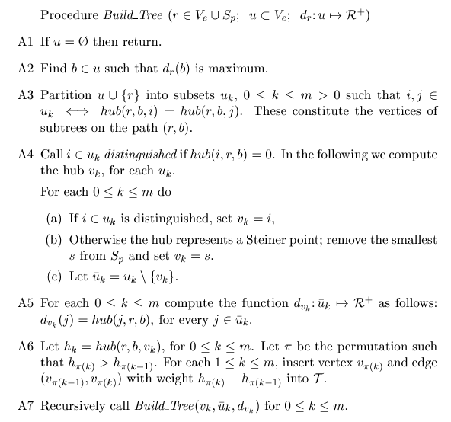

Slide 7
u₂
r
b
r₁

Slide 8
n vertices
n vertices

Slide 9
Find the maximum in the distance matrix D

Slide 10

u₂
u₁
u₃

Slide 11
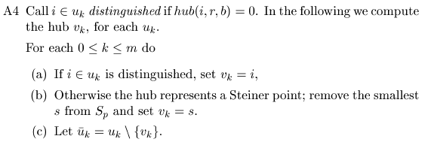
Hub (distinguished)
hub
Situation (a)
Situation (b)

Slide 12

Computed the dist. from j to the V_{k} in each subset.
Computed the dist. from r to V_{k}. And connect the (V_{π(k-1)} ,V_{π(k)})

Slide 13
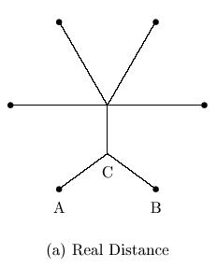
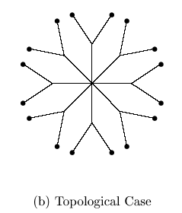
Run time analysis

